Slide 1
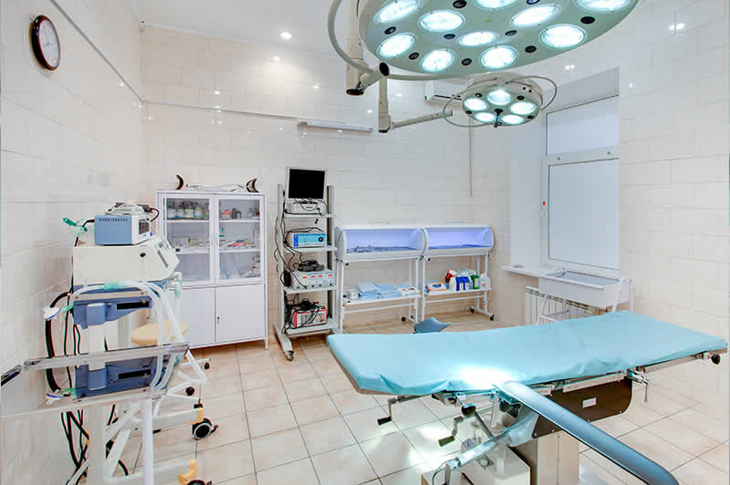
Lab Data Management System Project Work - 2
Topic : Medilab

Slide 2

Project By:
Name : Sudeshna Bhushan
USN : 1BM19CS189
Name : Nandita Mahendra
USN : 1BM19CS203
Name : Rubiana Josephine Paul
USN : 1BM19CS208
Name :Dyuthi Abhitha Prakash
USN : 1BM19CS196

Slide 3
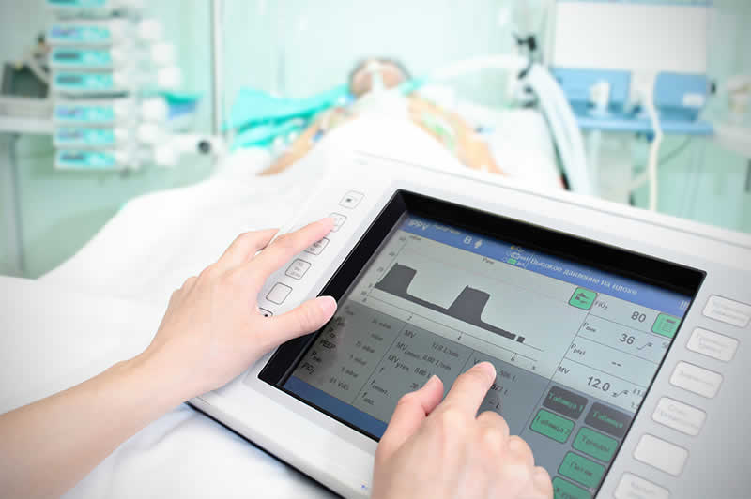
Under The Guidance of :
Mr. Lohith J J

Slide 4

ABSTRACT
Medilab is a diagnostic lab that has implemented the “LAB DATA MANAGEMENT SYSTEM” to maintain its records of most of the aspects carried out in the laboratory such as appointments, emergency facilities, and many more.

Slide 5


INTRODUCTION
Medilab is a diagnostic lab that has implemented the “LAB DATA MANAGEMENT ” to maintain its records of most of the aspects carried out in the laboratory such as appointments, emergency facilities, and many more
This web application is developed in such a way that it can be fitted to any of the devices such as desktops, laptops, tablets, hence it is a responsive web application.
This project is general purpose “Web Application” that can perform several tasks such as enquiring facilities service for the patients. And for the doctors and management a separate authentication portal is provided, from which two authentications are availed, one of the admins to manage and supervise the lab records by updating their reports through online or offline also.

Slide 6
Objective of this Project
• To provide an online platform to the patients to get the appointments.
• To provide the user-friendly environment
• The management can easily supervise the system and have a good control over each and every records.
• To make it easy to use for everyone.
• To work fast and accurate.
• To be time efficient.

Slide 7
Users
Management/Admin
Manages and supervises the doctors.
Supervises the patient records.
Supervises the emergency cases and ambulance bookings.
Views the signup and logs.
Read the contact forms.
Manage the subscription E-mails for any enquiry and checkups.
Can delete and edit some of the entries
Doctors
Views the appointments.
Attends the emergency cases.
Treats the patients in the scheduled time.
Patients/End Users
Views the hospital system.
Gets email subscription.
Gets ambulance booking service
Gets online appointment scheduling
Can contact the management
Can write a mail
Can directly call
Gets 24X7 services
View the services offered
Can view and access the google map

Slide 8
Advantage
Easy to use.
User-friendly
Attractive
Anyone can understand the concepts of hospital.
Minimized data-entry.
Saved a lot of paper work.
Saves lot of time.
Reduced risk of accuracy.
Minimized effort and time.
Fast processing time.
Email subscription
Google map
Can directly call from the site
Can directly write mail to the management

Slide 9
System Requirements
Software & Hardware

Slide 10

System Requirements
Processor | Ram | HDD/SSD | Device
I3 or Higher | 2GB or Higher | 120Gb Standard | Laptop / Desktop / Tablet / Cell-Phone
Basic Requirements

Slide 11
Hardware requirements
Frontend | Backend | Server Side | OS | IDE | Local Server
Bootstrap [ HTML, CSS] | MySQL | PHP | Windows 7 & Higher | Microsoft VS Code | XAMPP
Basic Requirements

Slide 12
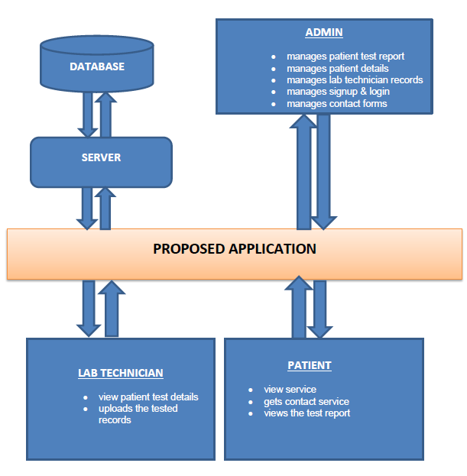
Architecture Diagram

Slide 13
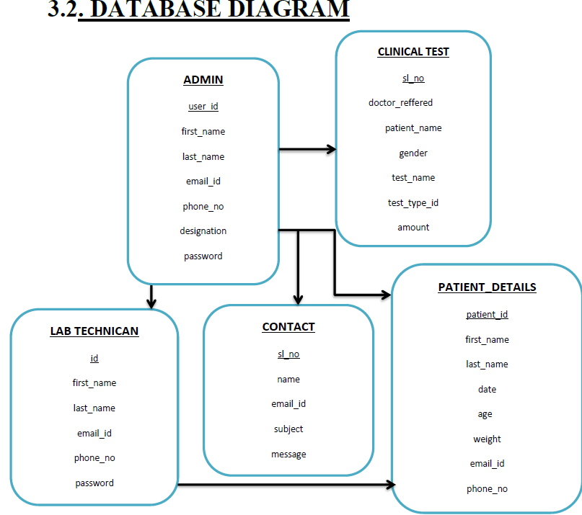
Database-Diagram

Slide 14
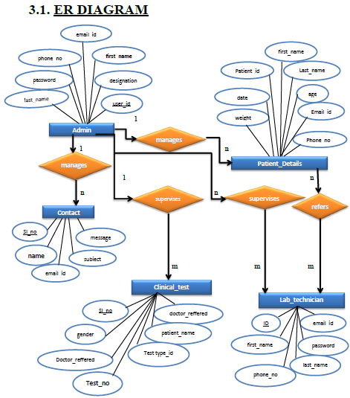
ER-Diagram

Slide 15
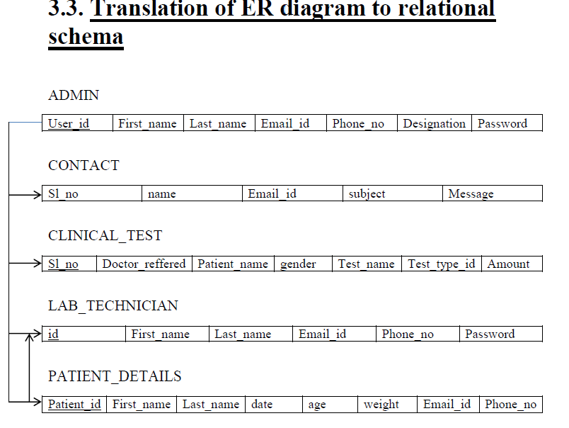
Schema Diagram

Slide 16
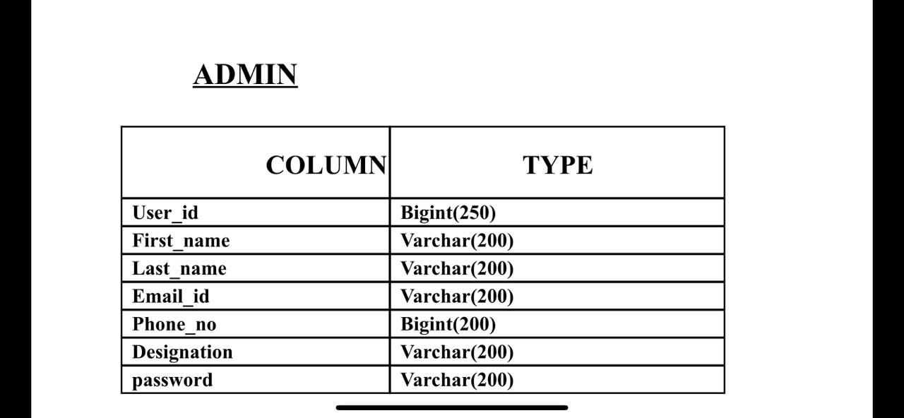
Tables used in the project

Slide 17
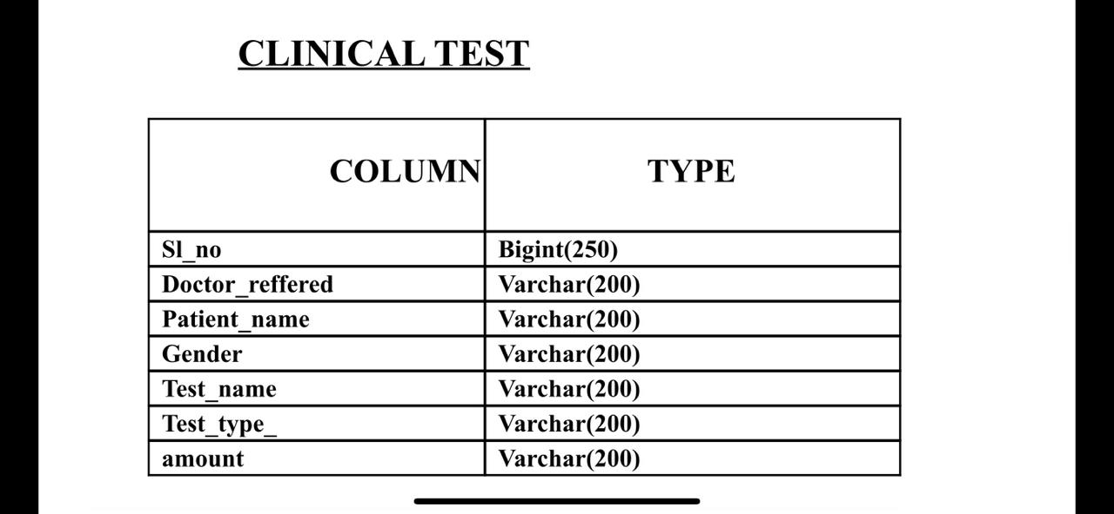

Slide 18
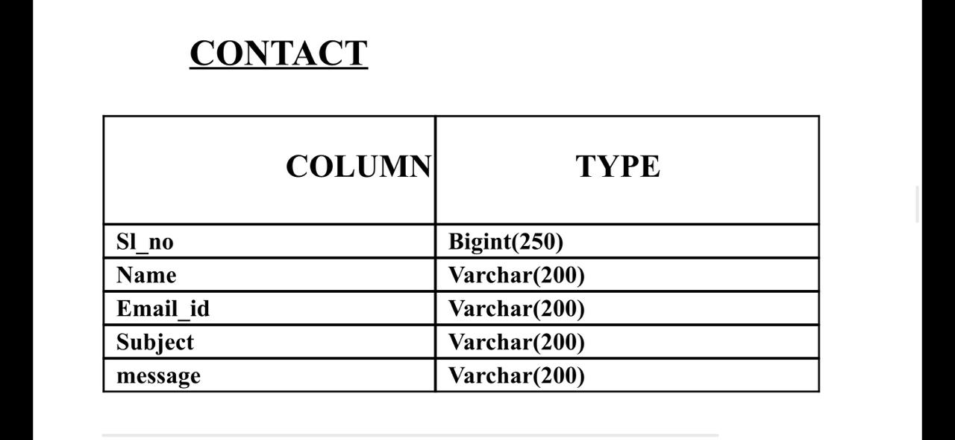

Slide 19
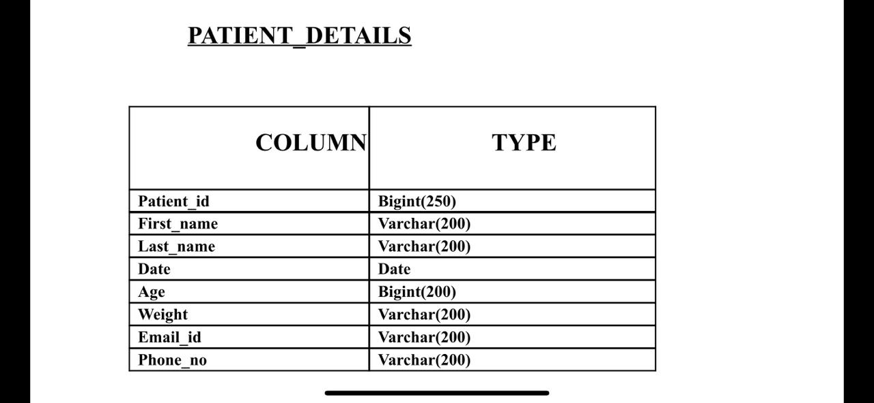

Slide 20
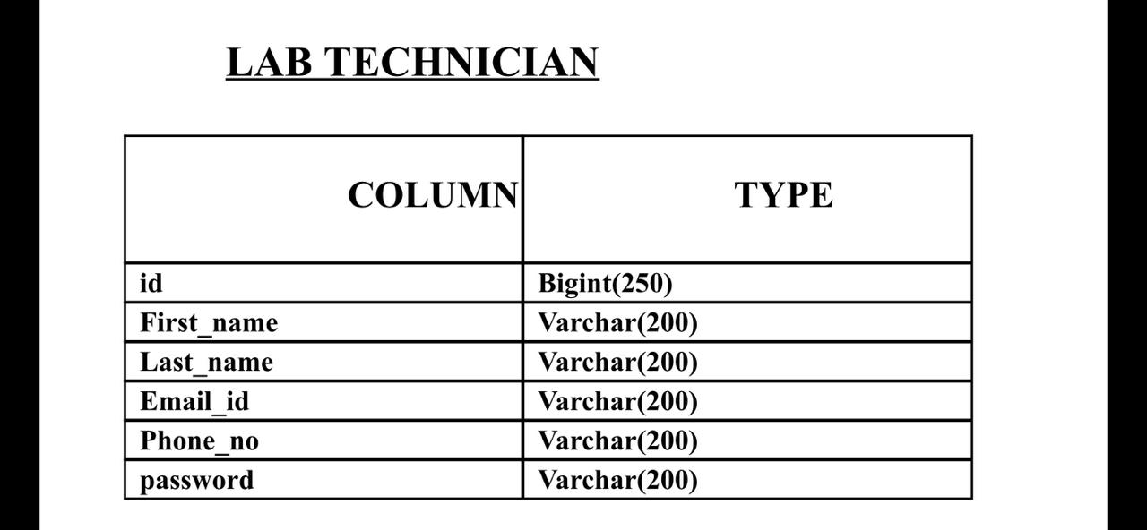

Slide 21
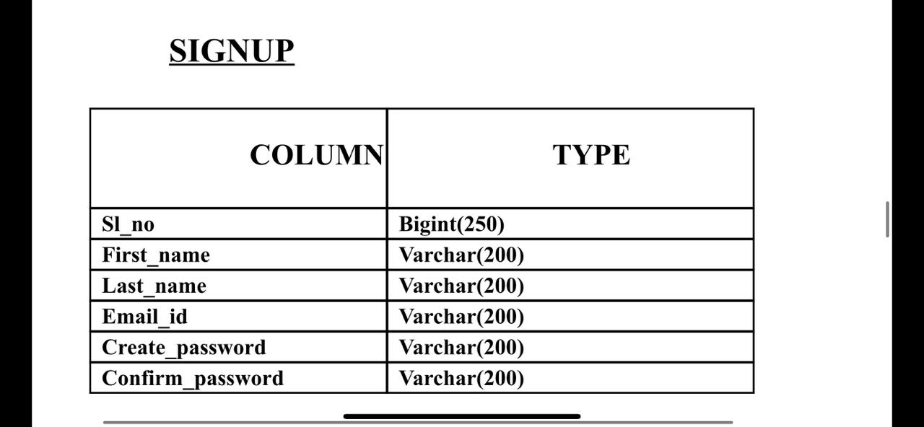

Slide 22
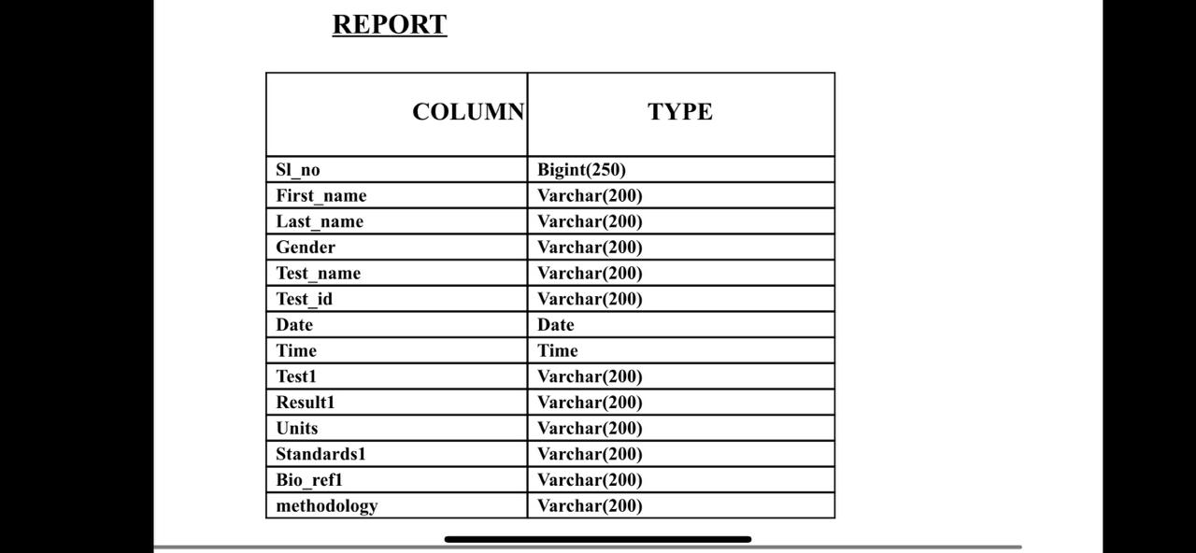

Slide 23
Implementation and Issues
Implementation is the stage of project where the theoretical design is turned into a working system. It can be considered to be the most crucial stage in achieving a successful new system gaining the users confidence that the new system will work and will be effective and accurate. It primarily concerned with user training and documentation.
Conversion usually takes place about the same time the user is being trained or later. Implementation simply means convening a new system design into an operational one.
If the implementation is not carefully planned and controlled. It can create confusion.
Implementation includes all those activities that take place to convert from the existing system to the new system. The new system may be totally new. Proper implementation is essential to provide a reliable system to meet organization requirements. The process of putting developed system in actual use is called system implementation. This includes all those activities that takes place to convert from the old system to the new system.

Slide 24
Software Testing
The process of executing a system with the intent of finding errors can be defined as testing. It can also be defined as the process that defines as the process that defines, isolates, subjects to rectification of defects, and so that the customer satisfaction is reached at last with assurance of the system is free from defects.
Software testing is a very important element of the quality assurance and it represents the SRS, designing, coding and implementation of the system proposed.

Slide 25
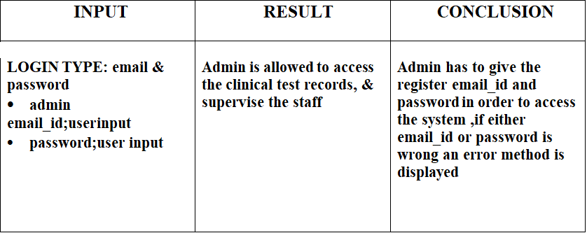
Test Cases
Admin Login

Slide 26
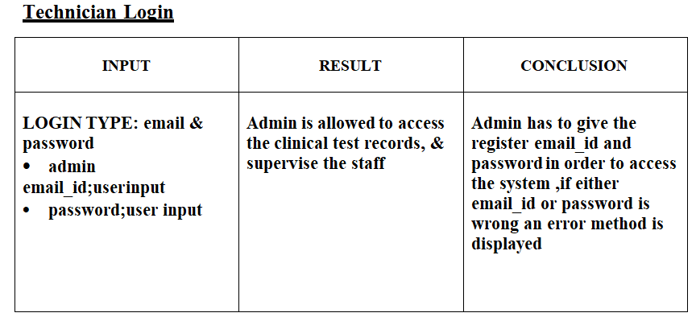

Slide 27
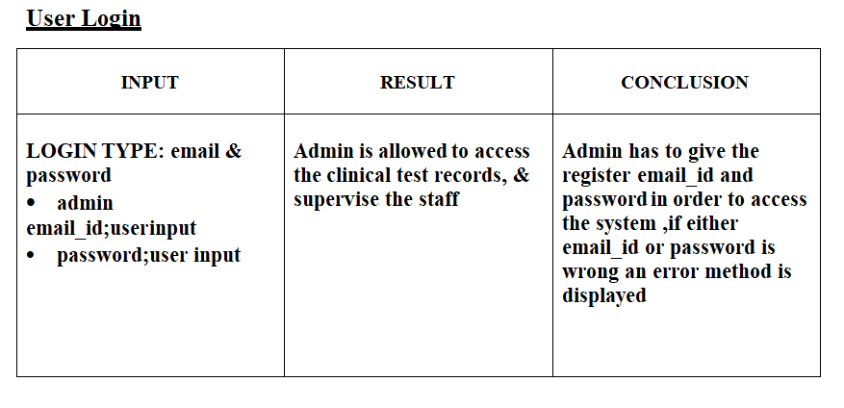

Slide 28
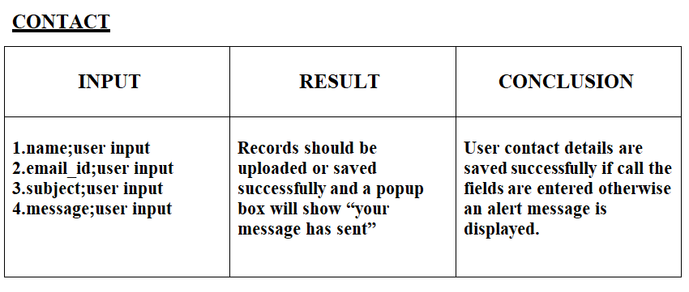

Slide 29
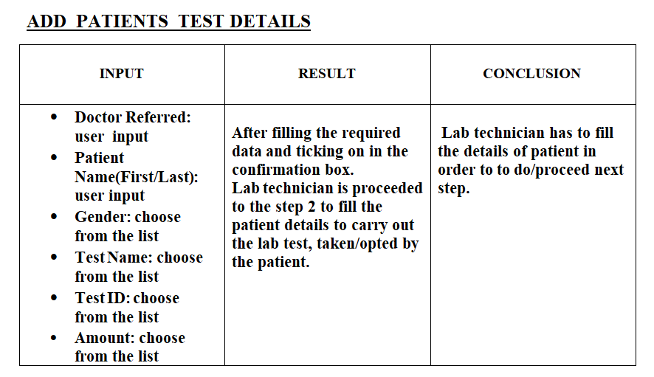

Slide 30
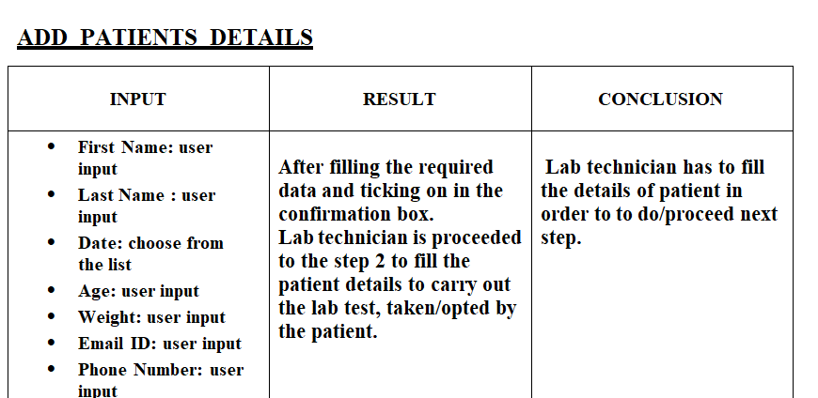

Slide 31
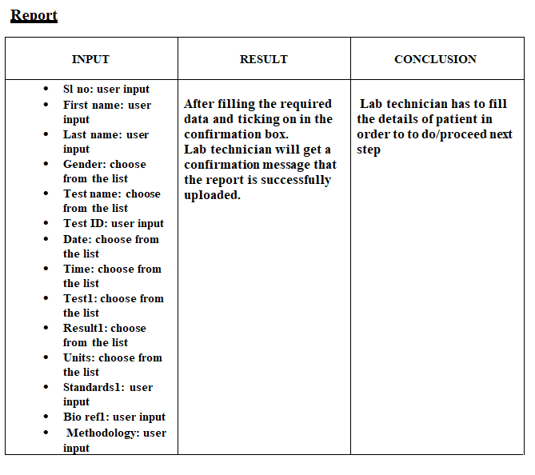

Slide 32
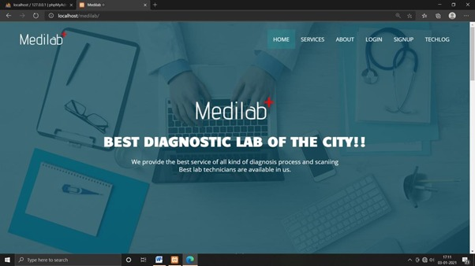
Screenshots
Home screen

Slide 33
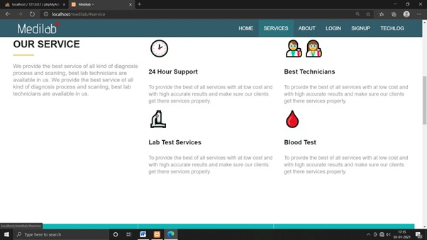
Services offered page

Slide 34
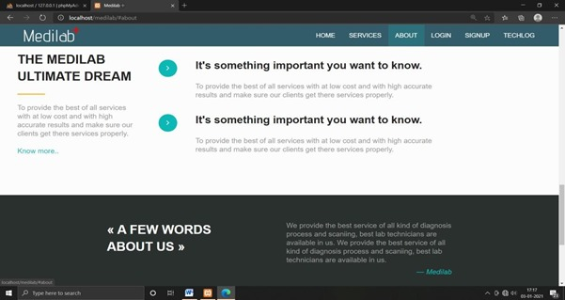
About Us

Slide 35
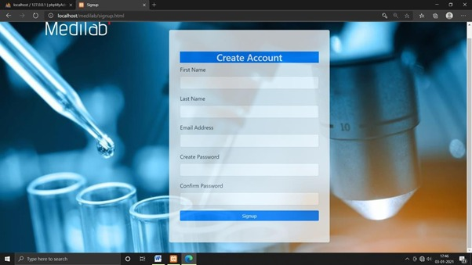
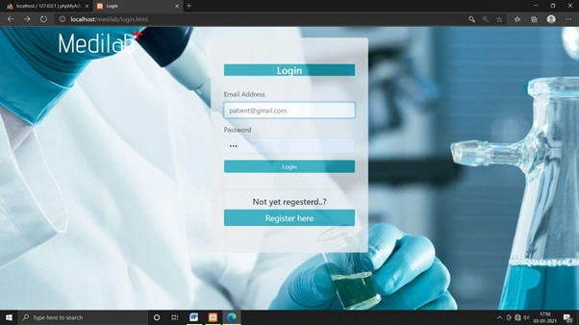
Patient Sign up form
Patient login form

Slide 36
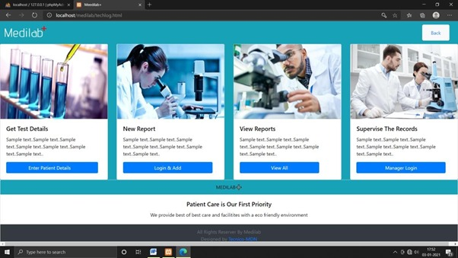
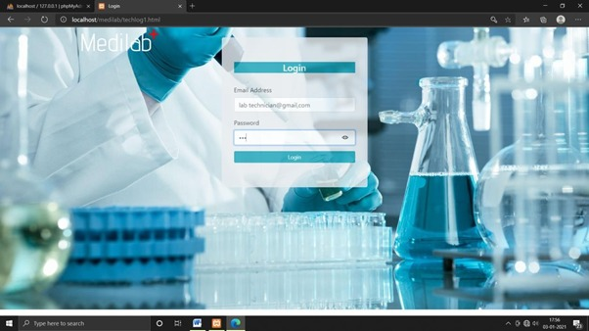
Lab technician login Enter Patient details

Slide 37
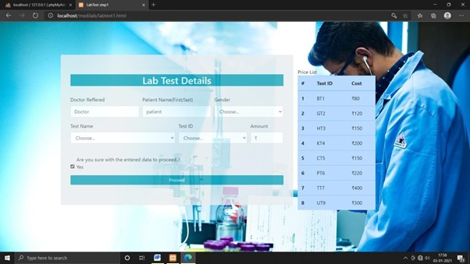
Lab test details

Slide 38
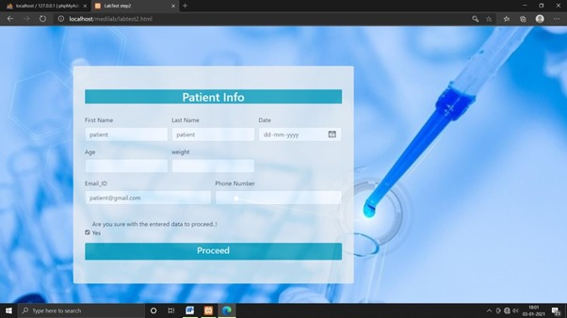
Patient info

Slide 39
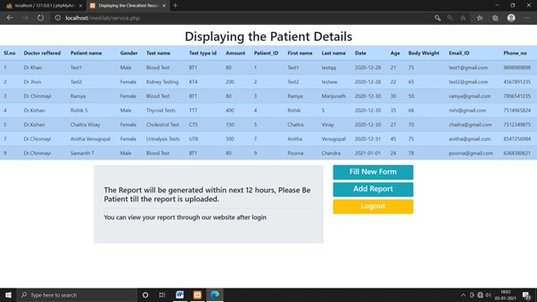
Displaying Patient details

Slide 40
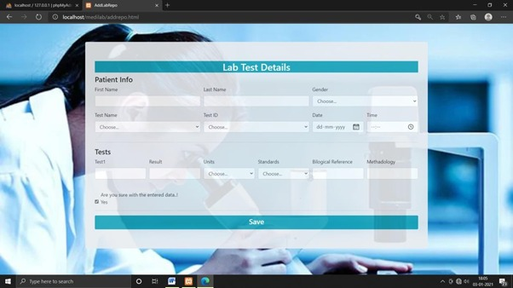
Add Report Details

Slide 41
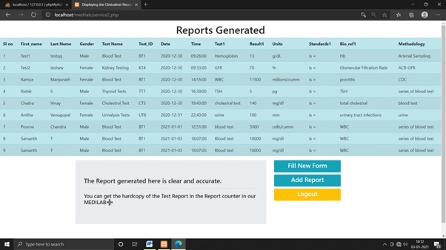
Report Generated

Slide 42
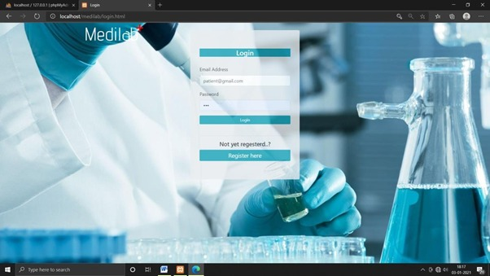
Patient Login to Report

Slide 43
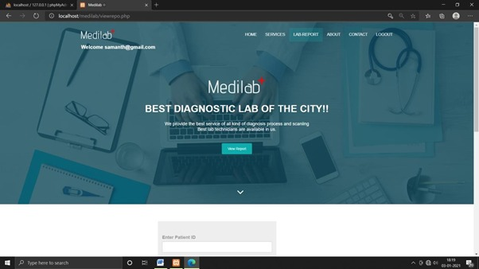
View Lab Report

Slide 44
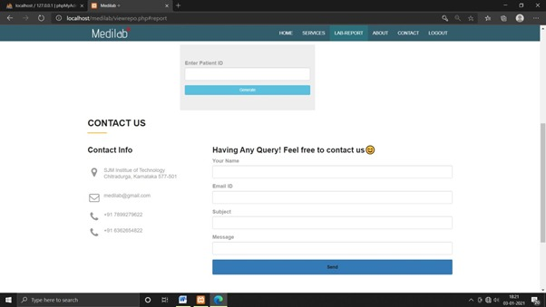
Enter Valid Patient ID

Slide 45
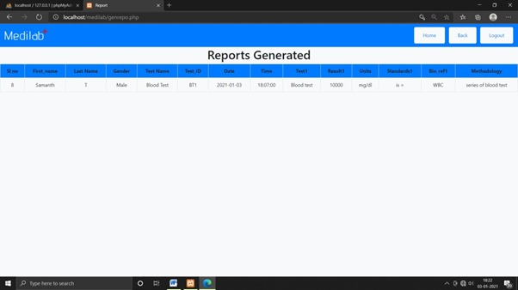
Reports Generated

Slide 46
Conclusion
The “LAB DATA MANAGEMENT” is a database management system adopted by the lab named “MEDILAB” to have a general-purpose web application in which both the laboratory staff and the clients/patients can get the benefit from it.
It is developed in such a way that the patients can book an appointment online through our website where as well can get the ambulance service, where as the doctors can view their appointment schedules and above all, the hospital management can easily supervise and maintain the records of doctors, patients, emergency service, email subscriptions and contact forms and have complete control over it.
This project is an attempt to provide a platform for the users and the service providers to save time and maintain accuracy with reduced paperwork and time and to provide the details of the service provider to the client, so that they can understand and learn about the facilities provided by the service provider (Hospital).

Slide 47

References

Slide 48

THANK YOU!

